Slide 1
EOS Pre-Lab
Yu-Lun Huang
2011/9/19

Slide 2
Outline
Download VMware Player & Ubuntu
Create Virtual Machine & Install Ubuntu
Install Essential Packages
Introduction to Vim
Introduction to GCC Compiler
Introduction to Man Page

Slide 3
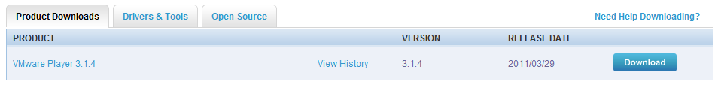
Download VMware player (1/3)
Website:
http://downloads.vmware.com/d/info/desktop_downloads/vmware_player/3_0

Slide 4
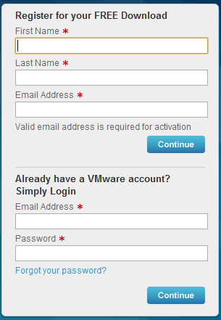
Download VMware player (2/3)
Register for free download

Slide 5
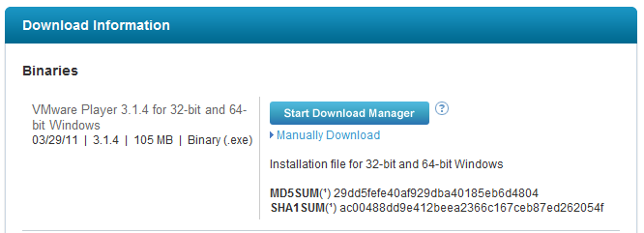
Download VMware player (3/3)
Click the button to start download
Run “VMware-player-3.x.y-z.exe” to start installation
Reboot system to validate the changes after installation

Slide 6
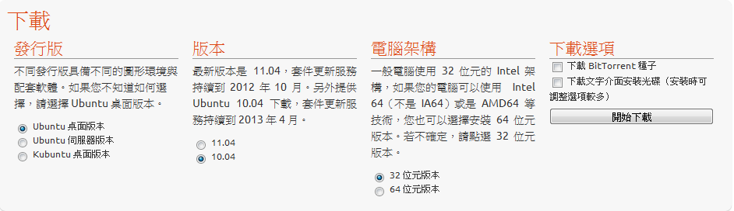
Download Ubuntu
Website:
http://www.ubuntu-tw.org/modules/tinyd0/
We suggest to download Ubuntu 10.04 for long tern support (ubuntu-10.04.3-desktop-i386.iso)

Slide 7
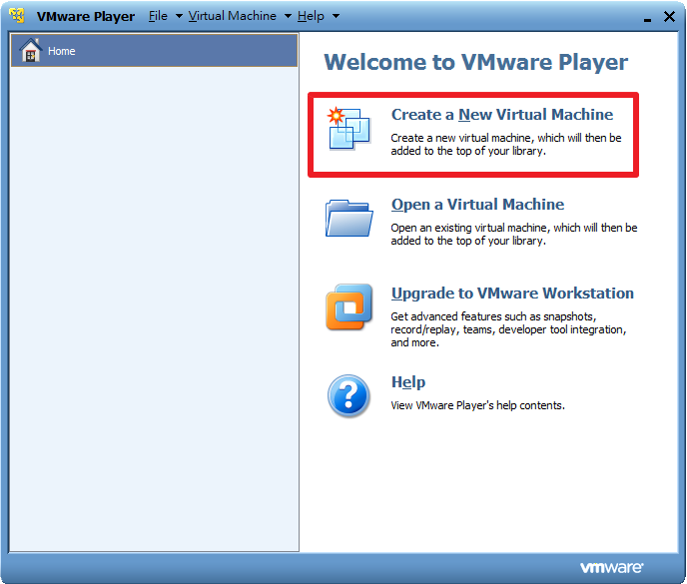
Install Ubuntu (1/6)
Run VMware player
Create a new virtual machine

Slide 8
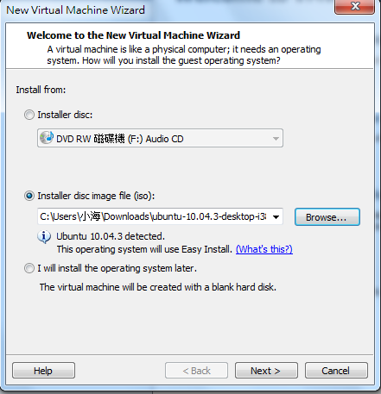
Install Ubuntu (2/6)
Set the path to Ubuntu image (ubuntu-10.04.3-desktop-i386.iso)

Slide 9
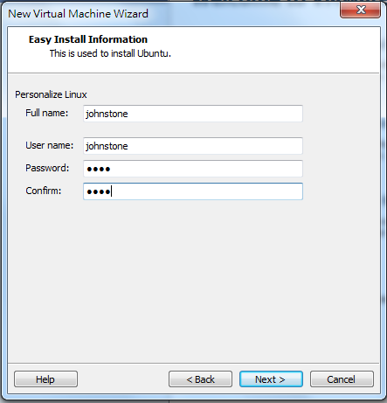
Install Ubuntu (3/6)
Set the user name and password

Slide 10
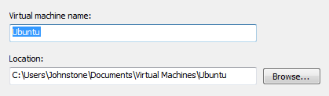
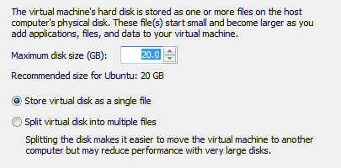
Install Ubuntu (4/6)
Set the installation path of virtual machine
Set the disk size for virtual machine

Slide 11
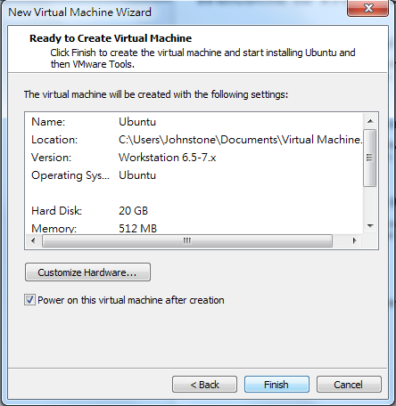
Install Ubuntu (5/6)
Click “finish” to start the installation process
Or click “Customize Hardware …” for detail settings

Slide 12
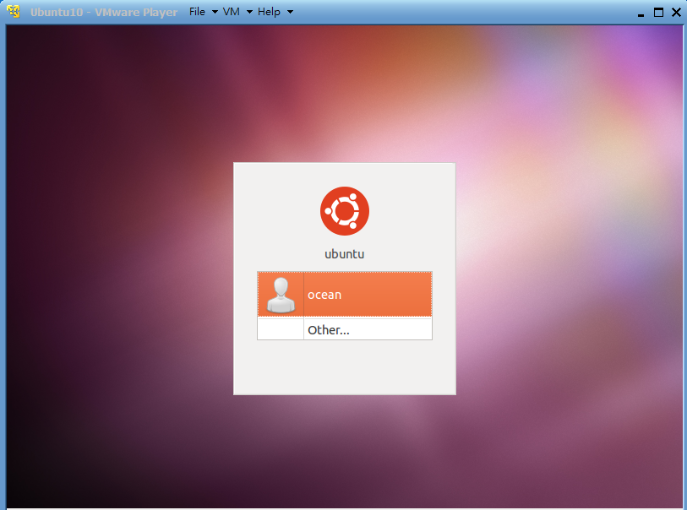
Install Ubuntu (6/6)
The installation process will take several minutes
The monitor will show a GUI login interface after installation
Login the system with the user/password set in P.9

Slide 13
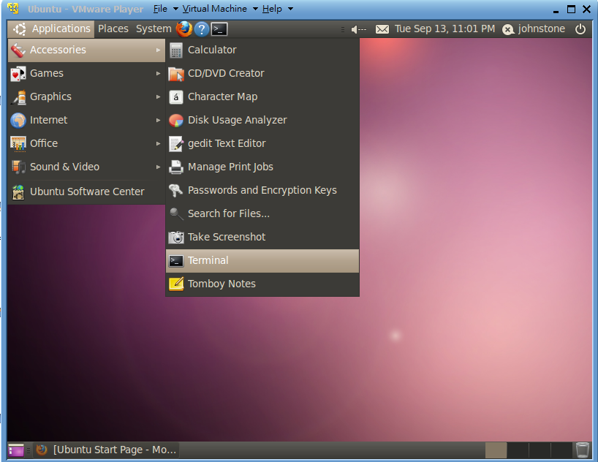
Install Essential Packages (1/4)
After login the system, open the “Terminal”

Slide 14
Install Essential Packages (2/4)
Check the internet connection before install packages
Type the following commands in the terminal
These will install vim, gcc compiler, and man page
sudo apt-get update
sudo apt-get install vim
sudo apt-get install build-essential
sudo apt-get install libc6-dev
sudo apt-get install manpages
sudo apt-get install manpages-posix
sudo apt-get install manpages-posix-dev
sudo apt-get install manpages-dev

Slide 15
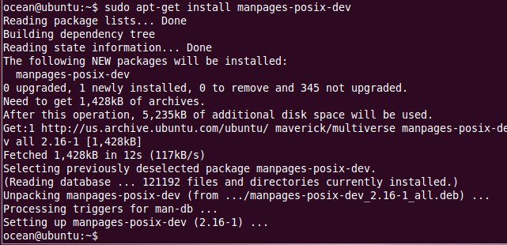
Install Essential Packages (3/4)
Package install successful example1

Slide 16
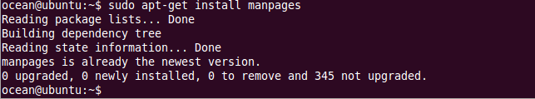
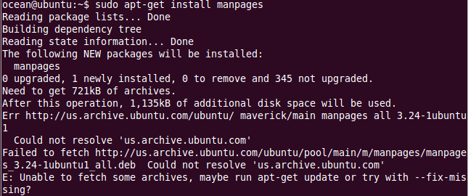
Install Essential Packages (4/4)
Package install successful example2
Package install failed example

Slide 17
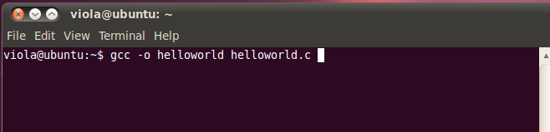
Introduction to GCC Compiler (1/3)
Use GCC compiler to compile source code into object file
gcc –o [object name] [source code …]

Slide 18
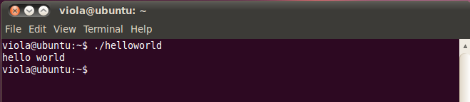
Introduction to GCC Compiler (2/3)
Use “ ./[Filename] ” to execute the object file

Slide 19
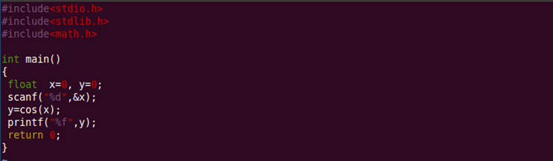
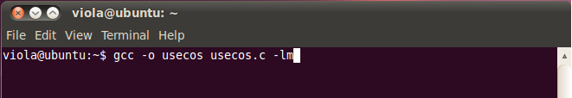
Introduction to GCC Compiler (3/3)
Sometimes you should specify a linked library to the linker
gcc [object name] [source codes …] –l[library]
e.g. use “gcc -lm” to link the “libm.a” library, when you use cos() function in your program

Slide 20
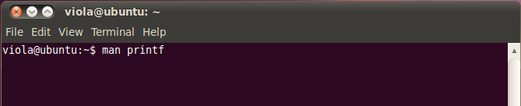
Introduction to Man Page (1/4)
Man page (manual pages) is a powerful manual in Unix
You can use “man [cmd]” to find its usage/definition
e.g. use “man printf” to find its manual

Slide 21
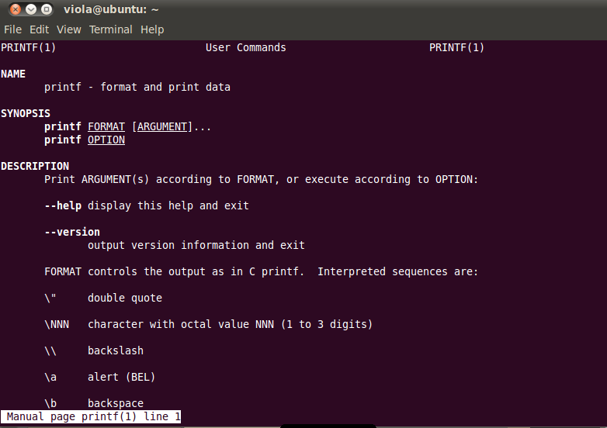
Introduction to Man Page (2/4)
The following picture shows the manual of “printf”
Enter “q” to leave the man page

Slide 22
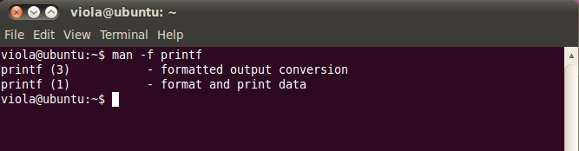
Introduction to Man Page (3/4)
Some commands have multiple usages/definitions
Different usages/definitions are classified into “sections”
Use “man –f [cmd]” to search available sections
e.g. “printf” has two sections
printf (1) is the guide of “printf” shell command
printf (3) is the manual of “printf” library call

Slide 23
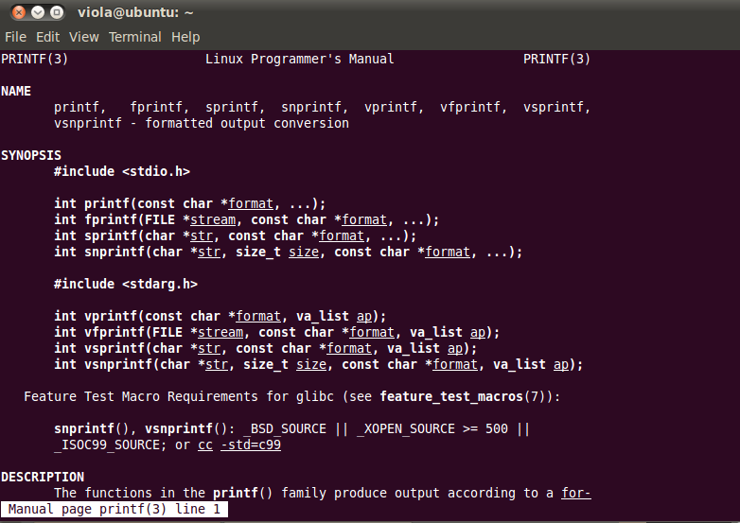
Introduction to Man Page (4/4)
Use “man [#sec] [cmd]” to access different sections
e.g., use “man 3 printf” to access “printf (3)”

Slide 24
Reference
Linux 基本指令
http://homepage.ttu.edu.tw/u9106240/page_main/linux.html
Vim 入門圖解說明
http://blog.vgod.tw/2009/12/08/vim-cheat-sheet-for-programmers/
鳥哥的 Linux 私房菜 – vim 程式編輯器
http://linux.vbird.org/linux_basic/0310vi.php
GCC 常用編譯參數
http://puremonkey2010.blogspot.com/2010/12/linux-gcc.html

Slide 25
Network Configuration

Slide 26
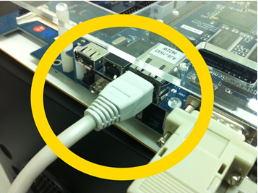
VMWare Player: Network Configuration
192.168.0.1
VMWare Player
Windows (IP1)
IP1
IP2
Linux (IP2)
Windows Bridge
IP3
(Or IP4)
VMWare Player: Bridge
Windows: Bridge IP1 & IP2

Slide 27
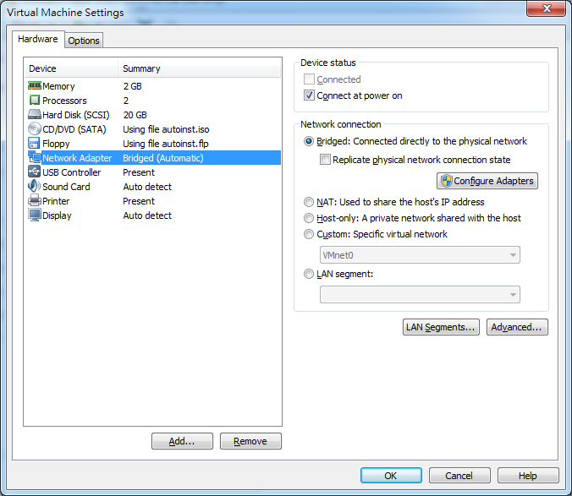
VMWare Player

Slide 28
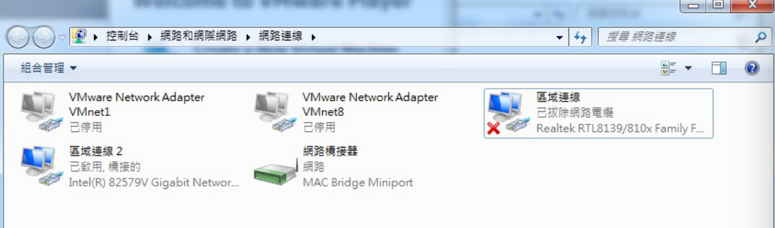
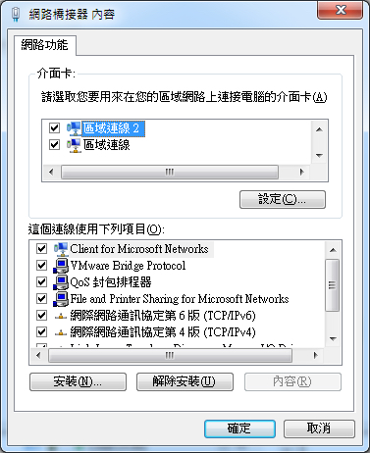
Windows Control Panel

Slide 29
PXA270 Setup

Slide 30
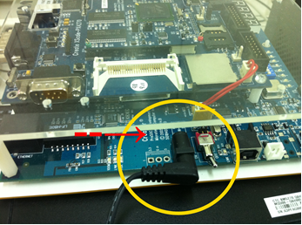
Device Setup
Connect power

Slide 31
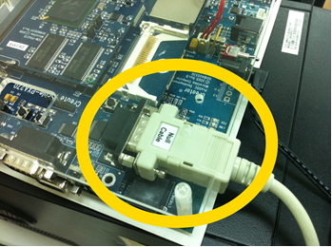
Device Setup
Connect RS232 (Null cable)

Slide 32
Device Setup
Connect network cable

Slide 33
Lab 1
Yu-Lun Huang

Slide 34
Lab 1-Initialization
Configuration (connectivity, networking, packages)
Bootloader (U-Boot)
Kernel
M1: The zImage is an executable decompression
M2: Bootloader helps decompress zImage to RAM
Root Filesystem
Create a new rootFS when adding a new file
Set up NFS to test the application in development

Slide 35
Lab 1 Assignment
請寫個計算n個數的最小公倍數lcd的程式，用 argc，argv 輸入參數
例如：
> ./lcd 3 2 5
> 30
不用 demo

Slide 36
Lab 2
Yu-Lun Huang

Slide 37
Lab 2 -- Module
Modules extend the functionality of kernel
Modules add new functionality w/o reboot
Device driver is a type of module

Slide 38
Lab 2 -- Kernel Configuration
Linux is a modular operating system
Built-in modules
Enable the settings in the kernel configure
Build into the kernel image
Loadable modules
Compile individually
Load dynamically
Why rebuild kernel?

Slide 39
Lab 2 Assignment
把 Lab 1 Assignment 的 lcd 燒錄到 PXA270 上
不用 demo

